Slide 1
OSMO in the Art Room
Kerri Waller
OSMO Ambassador
@WallerArt

Slide 2
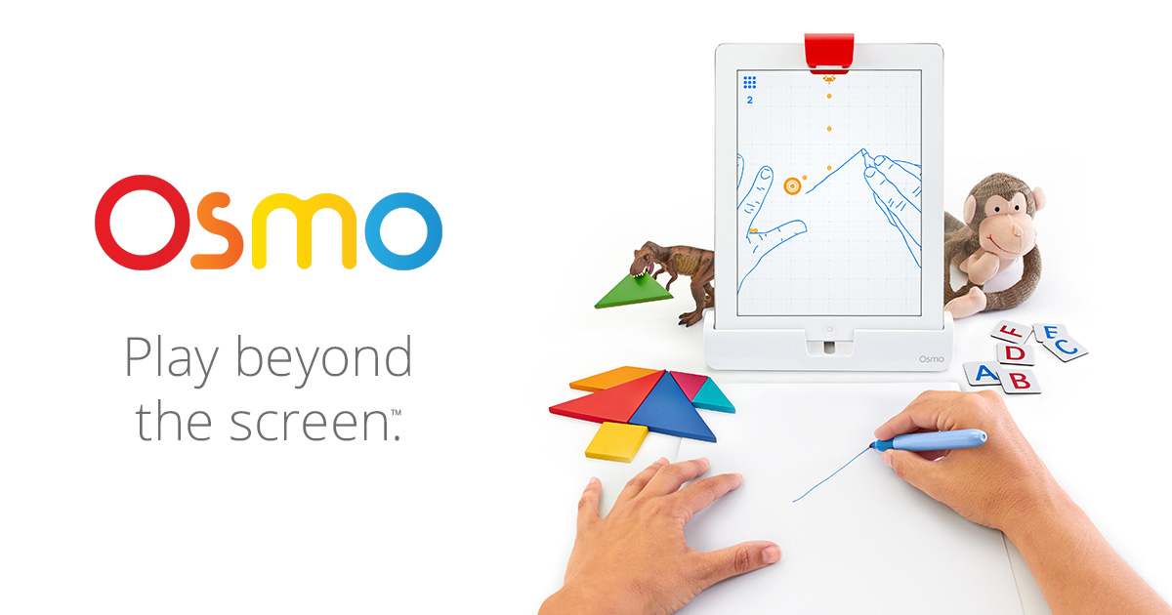
Intro
Osmo Intro Video

Slide 3
Still confused?
OSMO unit is a white base piece and a mirror encased in red plastic
Works with your iPad
Mirror redirects camera to record/photograph
In art class, we have been using the Masterpiece app and the Tangram app

Slide 4
My Cool Video
Demo Video

Slide 5
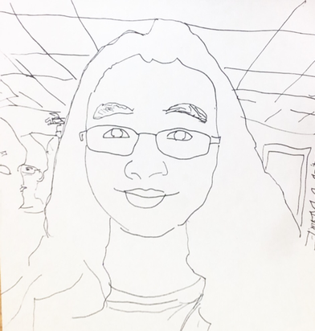
OSMO in the Art Room
Students who don’t traditionally appreciate art class come in before and after school to use
Motivational extension activity
Students can work individually or paired
Helps with focus
Great tech tool
All apps are free

Slide 6
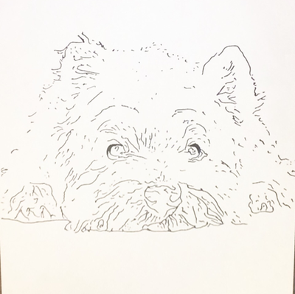
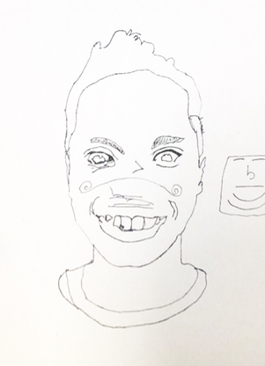
Downside to OSMO
Must have iPad
Must use iPad out
of case (yikes)
Kids can get dependent
Kids fight over it

Slide 7
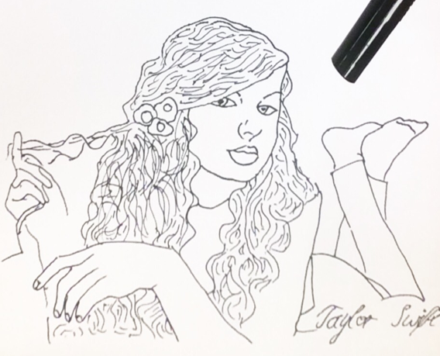
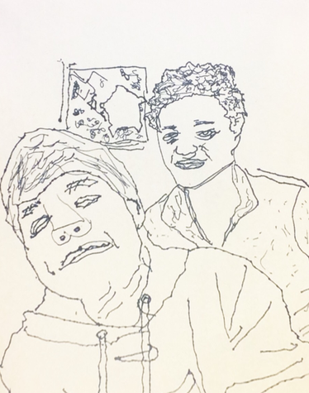
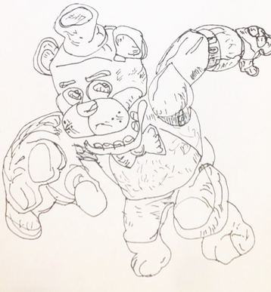
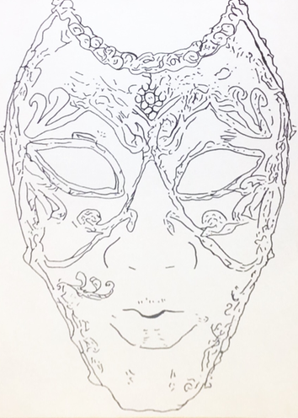
Student Examples
Mask Example
Rick Example
Student Portrait

Slide 8
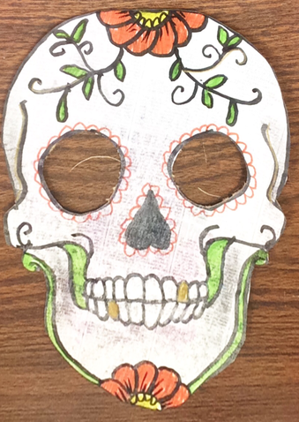
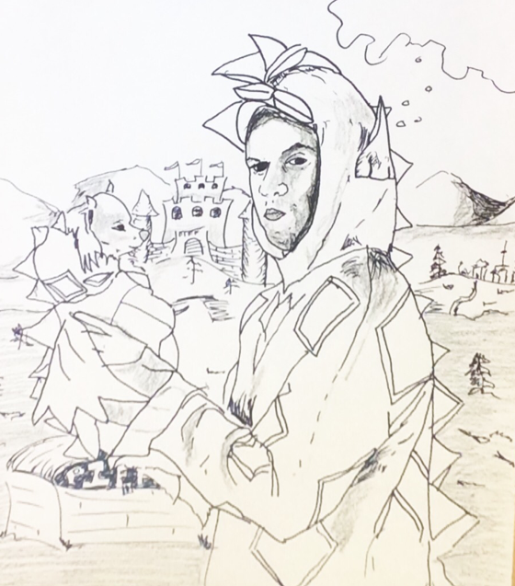
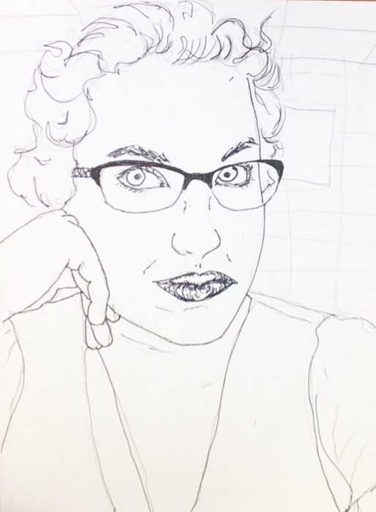
Teacher Examples
Portrait
Color Theory Portrait

Slide 9
Mixing Apps- Going Further
Screen shot OSMO drawing
Open in ChatterPix or MotionPortrait
Make a moving drawing that talks!
MotionPortrait OSMO Video

Slide 10
Mixing Apps- Going Further- Part 2
Open Holapex app
Create video by uploading speed art video (created with OSMO) or from ChatterPix or MotionPortrait
Create a hologram!

Slide 11
The End
Ask Questions. Stay Connected.
Check it out. Share.
Kerri.waller@cobbk12.org
Twitter: @wallerart
Pretendstudio.weebly.com

